Slide 1
Hybrid Movie Recommender System
Members : Brian Hsu
Yanzhou Zhang
Xiaohan Jiang

Slide 2
Introduction
Evaluating and comparing the accuracy of different models, find out the best combination of these models to create a high-precision hybrid movie recommendation system.
Algorithms implemented in the projects:
Collaborative Filtering Methods - Item-item based, KNNBasic Item-based, SVD
Content-based Method

Slide 3
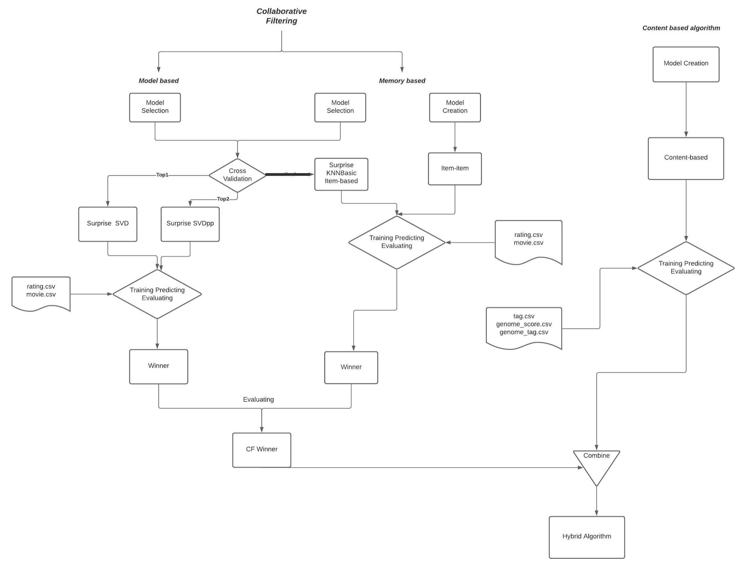
Project System Design

Slide 4
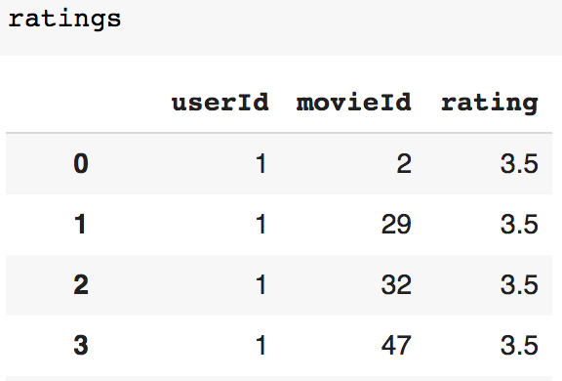
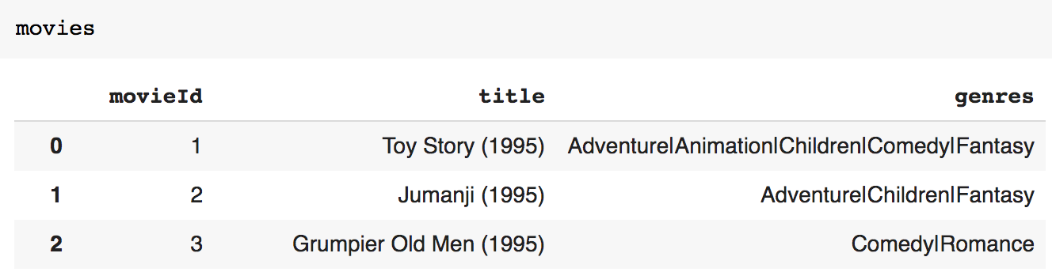
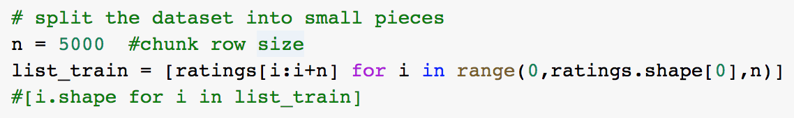
Data and Preprocessing
MovieLens : 20M Dataset
20000263 movie ratings 465564 tag /genre
27278 movies
The data was collected from a total of 138493 users between January 09, 1995 and March 31,2015
rating.csv & movie.csv

Slide 5
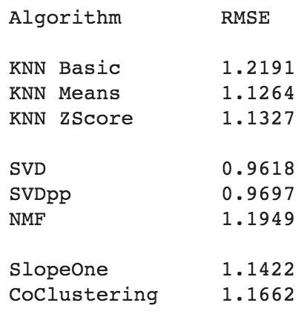
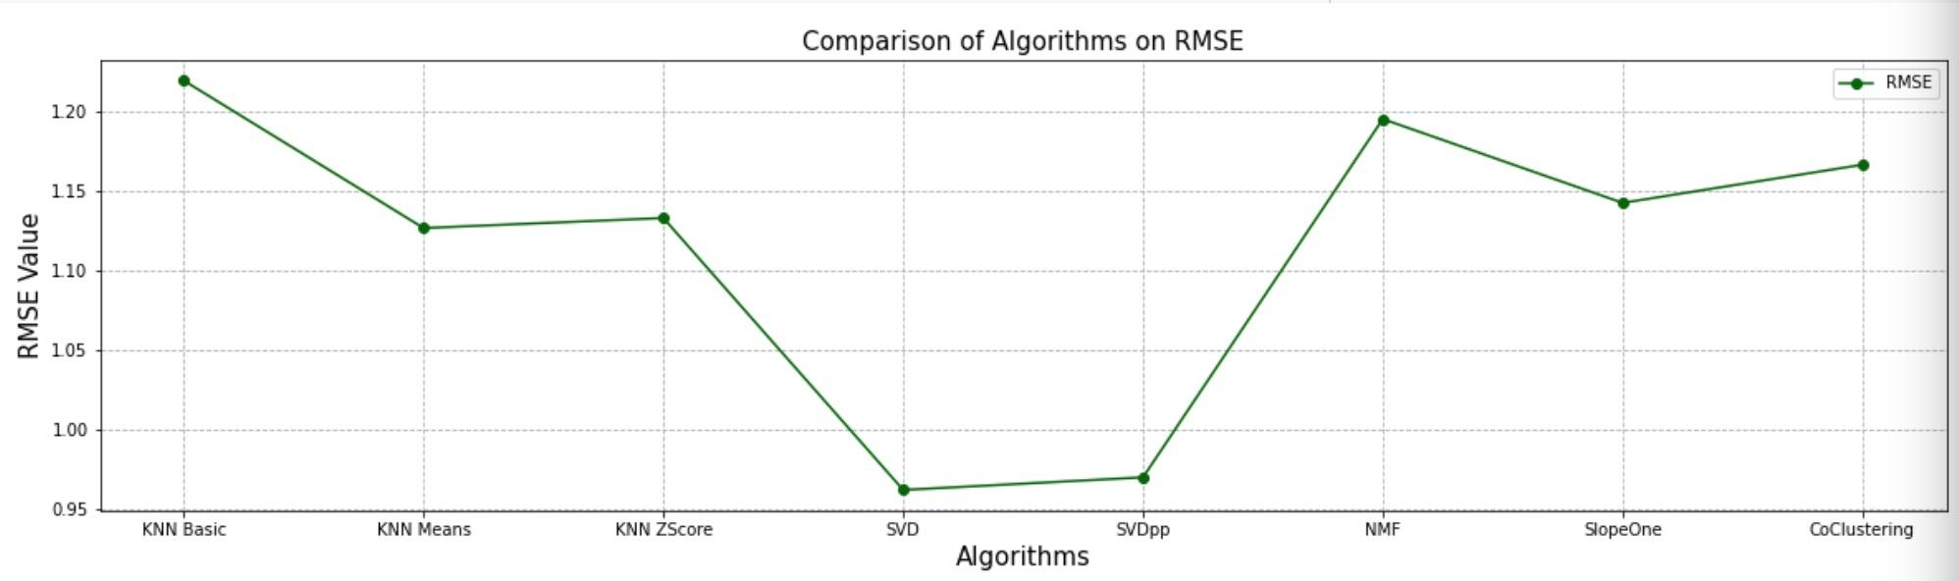
Methodology of Surprise Model Selection
1.k-NN Based Algorithms ： KNNBasic, KNNWithMeans and KNNWithZScore
2.Matrix Factorization Based Algorithms ： SVD, SVDpp and NMF
3.Other Collaborative Filtering Algorithms ： SlopeOne, CoClustering
Cross Validation: 5-Fold
Optimization Metric: RMSE

Slide 6
SVD & SVD++ Hyperparameter Tuning
Best Parameter Combination :
{'biased': True, 'lr_all': 0.01, 'n_epochs': 20, 'n_factors': 100, 'reg_all': 0.1}
RMSE of tuned SVD decrease more than tuned SVD++
The SVD++ algorithm, an extension of SVD taking into account implicit ratings.
Disadvantages of SVD++ : Longer tuning and training time, didn’t reduce RMSE to a ideal value

Slide 7
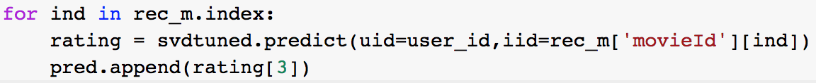
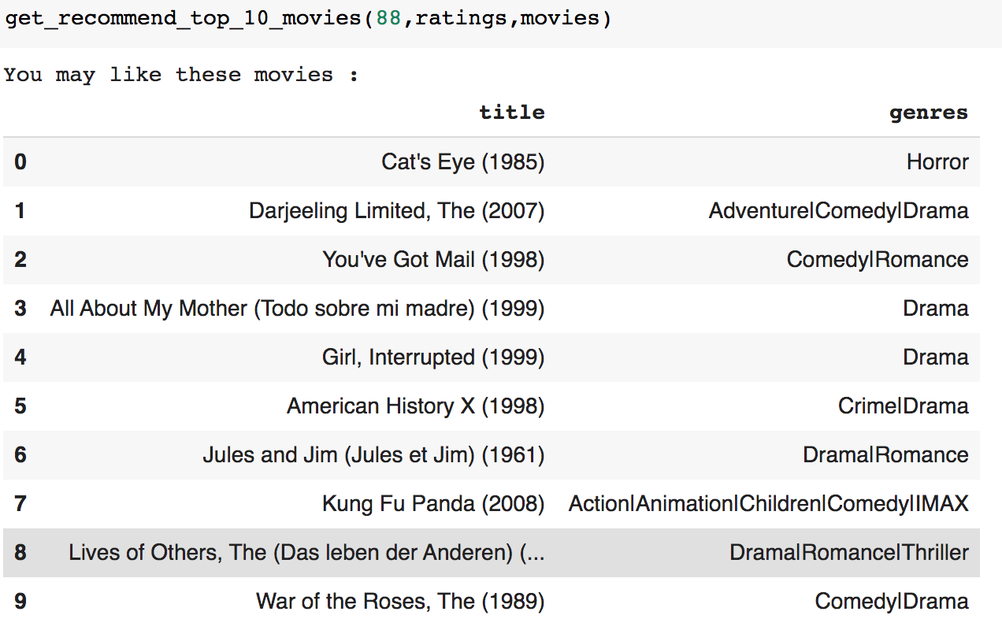
SVD Training and Predicting
Use all 20000263 data to train the model.
Predicting and Recommend
Find out movies that user U already watched
The list of movies that user didn't watched
Predict rating for every movie in the list
Recommend top predict rating movies

Slide 8
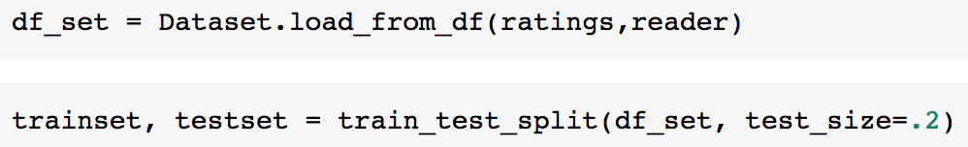
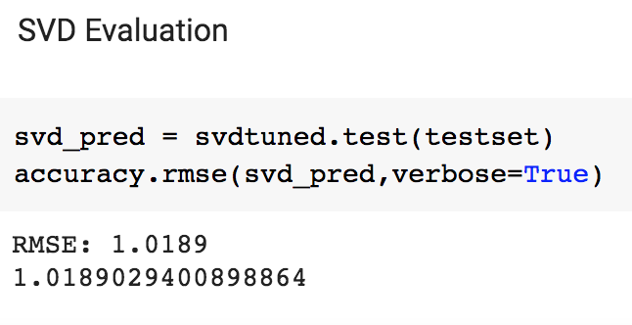
Evaluation

Slide 9
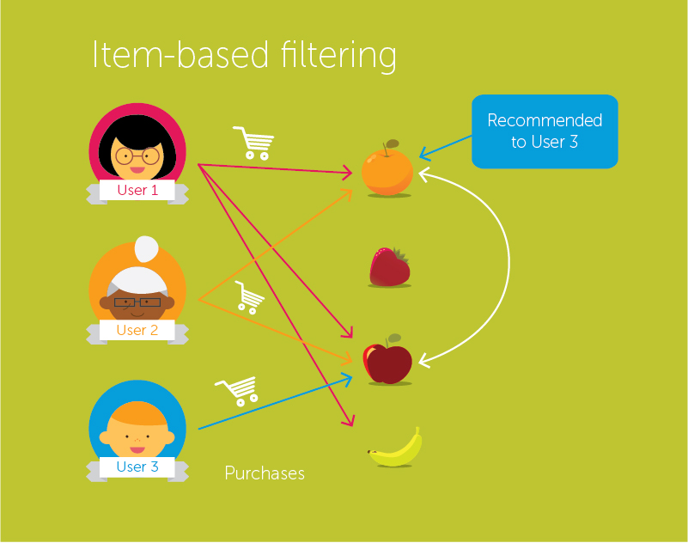
Methodology of Item-Item Based CF Model
Recommend the most similar items based on the items that the user has already rated
Item-Item Similarity: the similarity means how people treat two items the same in terms of like
Stable performance compared to User based collaborative filtering

Slide 10
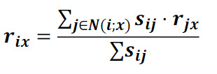
Implementation of Item-item based Model
Combine the information of users, their ratings, and their rated movies into one dataframe
Pivot table: columns - user id, index - movie id, values - ratings (missing value filled with 0)
Pairwise cosine similarity of all movies
Given a user id, find the user’s view history
Find similar movies
Prediction calculated using weighted average equation
Predict movies with best results

Slide 11
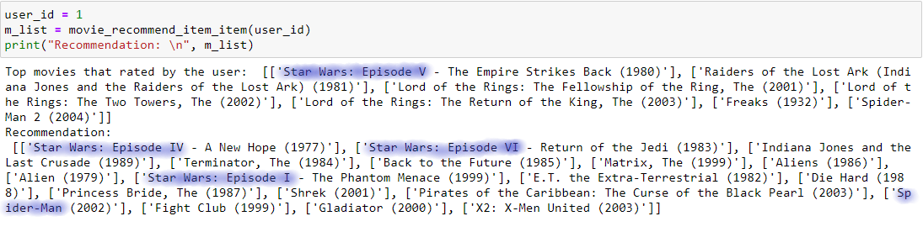
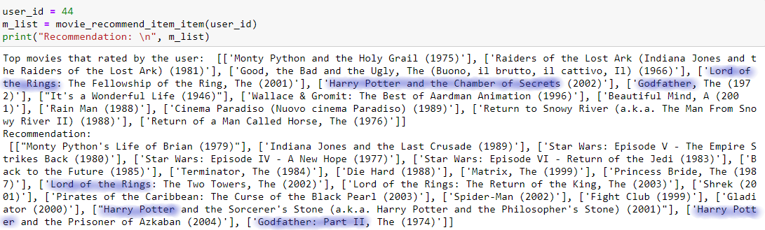
Sample Results

Slide 12
Evaluation
RMSE of Item-Item Based CF: 0.9188 (Vary from 0.85 - 1.15)
Limitation: Small portion of data used in evaluation
RMSE of Surprise Library’s Item-Based CF: 0.7318

Slide 13
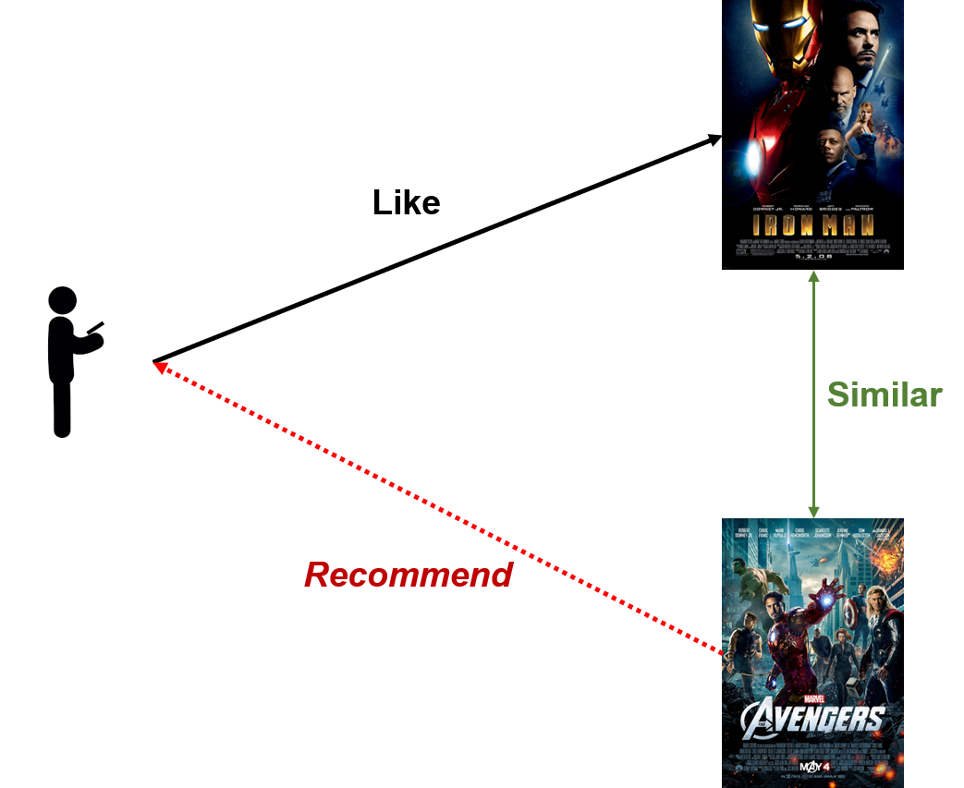
Methodology of Content-based Model
- Main idea
recommend items to user which have similar content to
content of previous Items rated highly by the user.
- What is content?
→ genres, tags, actor(s), director….
- How to recommend?
→ Create user profile and item profile and recommend items which have the most similar profiles to the user’s profile to the user.
Notes:
Hi professor, i’m brian, now i’m going to talk about the methodology of content-based model, the idea basically is what you see in the right figure, the model recommends movies that have similar content to the content of previous movie that the user liked before to the user, the content can be the genres, tags, actors or director of a movie. In the figure on the left for example, because both movies are hero movies starring tony stark so the model considers them similar, if you like iron man, the model recommend the avengers to you. To recommend using this method, we have to create user profile for each user and item profile for each movie and at the recommend movies that have the most similar profiles to the user’s profile to the user.

Slide 14
Method of Modified content-based model
A different way to implement recommend based on items’ content.
No need to create user profile by checking every movie the user watched.
Instead of calculating similarities between user-item, calculate item-item similarities.
recommend movies that have the highest total weight (degree of similarity) to the user.
Notes:
That was just a brief introduction for content-based model because what we implemented is a modified version of content-based model .
What i didnt mentioned in the previous slide is that how do we get user profiles? To get user profile, we need to go through every single movie the user watched to see what content the user like and what content the user doesn’t like based on the rating the user gave on that movie, which seems to be a very complicated process so we decided to build a model that is more intuitive, in this model we don’t need to create user profile and instead of calculating similarity between user and item, we calculate similarity between item and item and then recommend movies with the highest total weight to the user

Slide 15
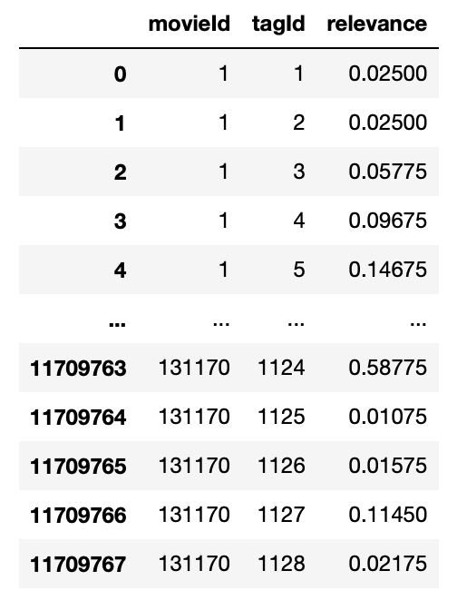
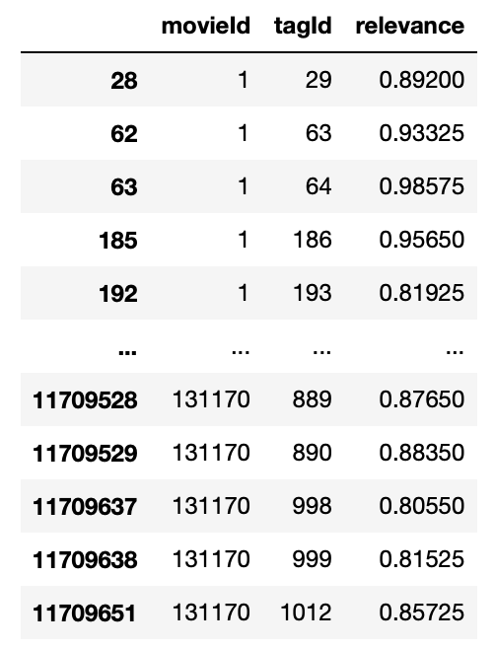
How?
Item profiles creation:
Step 1:
Extract tags that have relevance higher than 0.8 for each movie and add the tags information to each movie.
Notes:
So How do we implement the model? For item profile creation, step 1 is to filter the tags that have high relevance to the movies, the threshold we set is 0.8. After filtering we add those tags to the corresponding movie. We can see from the second table that the movie with movieid 1 has tags 29, 63, 64 and more.

Slide 16
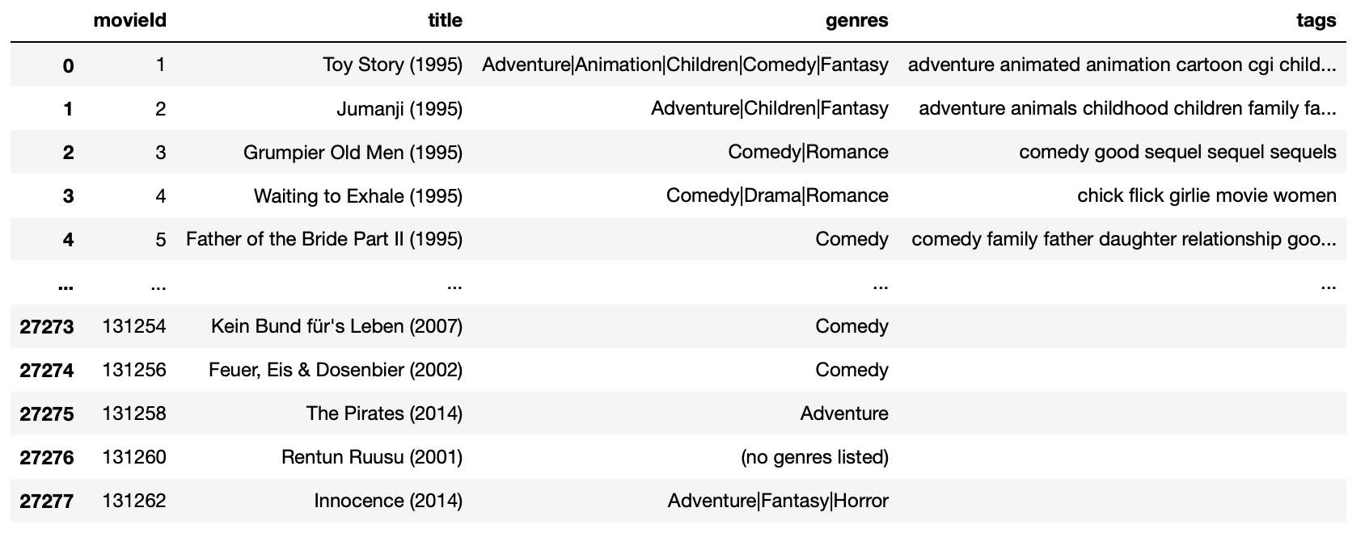
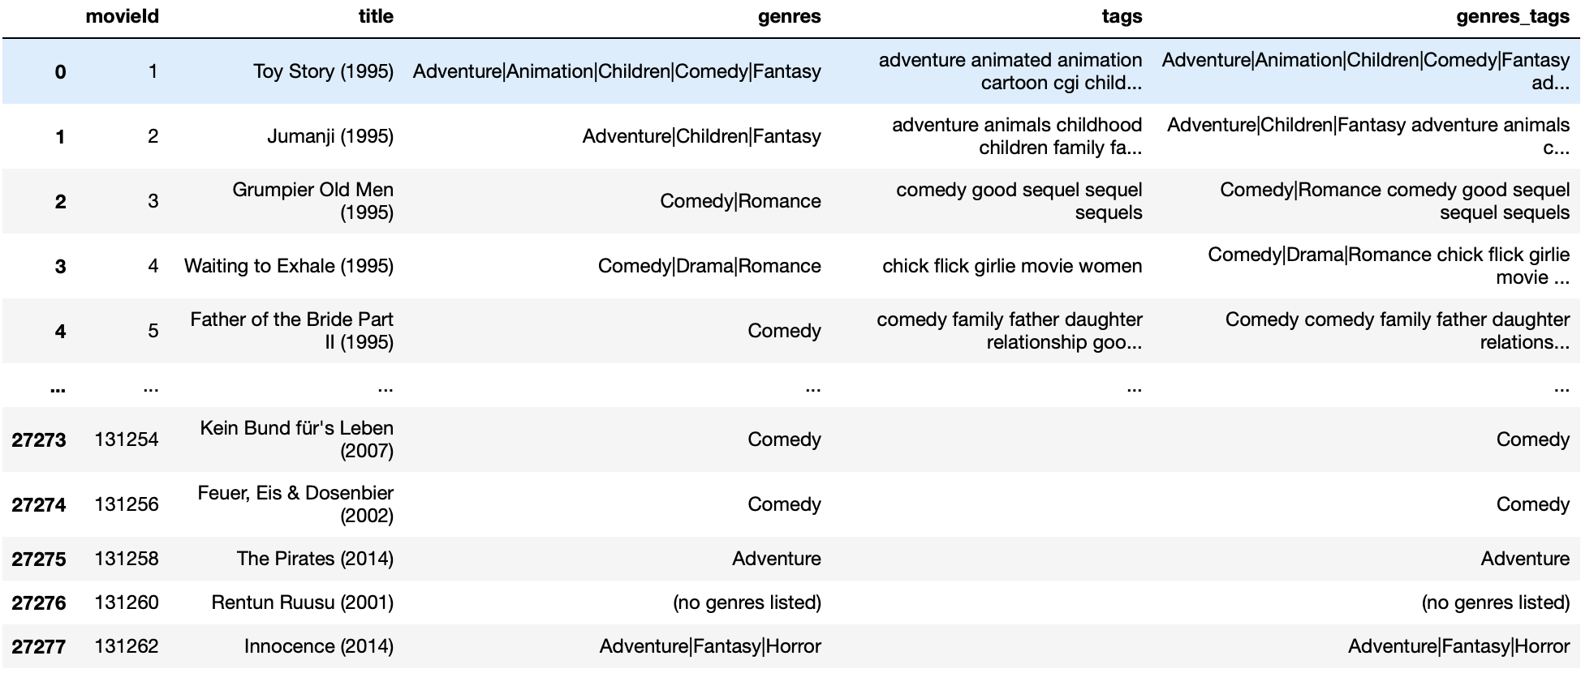
How?
Step 2:
combine genres information with tags information of each movie and perform TfidfVectorizer on the combined information to get item profiles.
Notes:
Step 2 we combine genres information and tags information of each movie and perform TfidfVectorizer on the combined information to get item profiles.

Slide 17
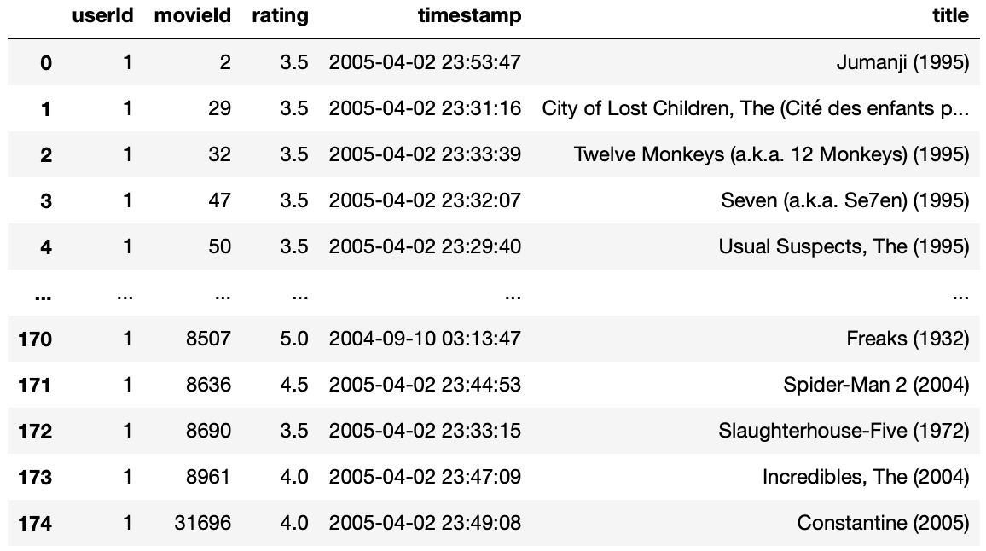
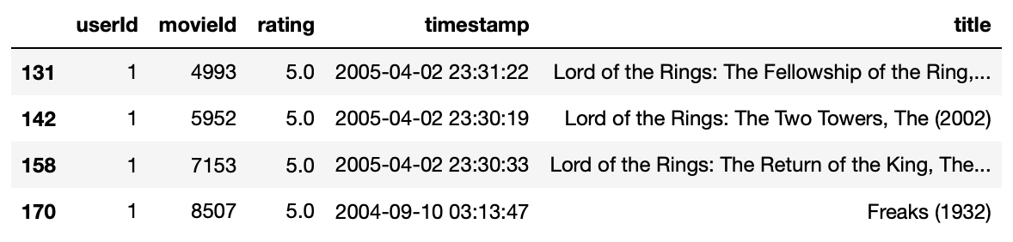
How?
Step3:
Instead of creating user profile for a user
checking all the movies he/she watched.
We select only movies he/she rated the highest.
Notes:
For the user part, step 3 instead of checking every movies the user watched to get user profile, we only extract movies that are rated the highest by the user.
You can see that the first table shows all the movies user 1 watched and the second table shows only movies that were rated 5 by user 1.

Slide 18
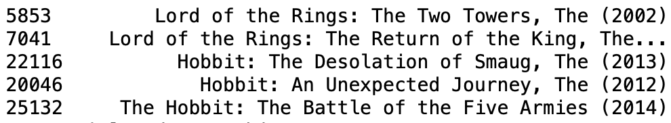
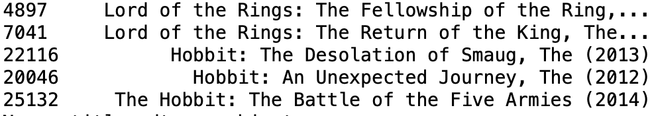
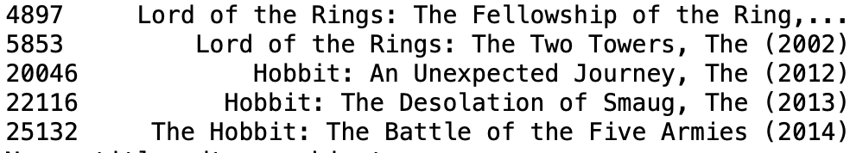
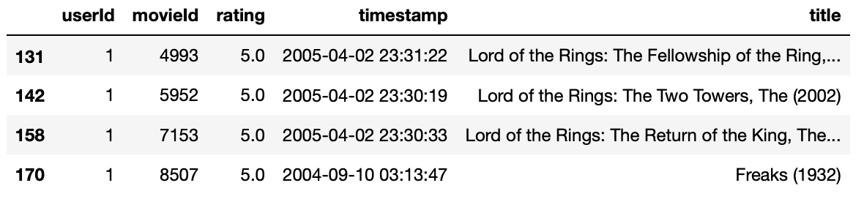
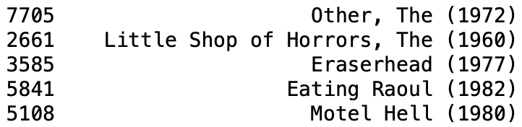
How?
Similar movies to movie with movie Id 4993
w=5
w=4
w=3
w=2
w=1
Similar movies to movie with movieId 5952
Step4:
For each movie we extracted in previous step, compute the similarity between itself and other movies and return top k similar movies with weights and add it to a list. (k = 5 in this case, the most similar one has the highest weight = 5 and the least similar one has the lowest weight = 1)
Similar movies to movie with movieId 7153
Similar movies to movie with movieId 8507
Notes:
Step 4 For each movie we extracted in previous step, we compute the similarity between itself and other movies and return top k similar movies with weights and add it to a list. (k = 5 in this case, the most similar one has the highest weight = 5 and the least similar one has the lowest weight = 1), let’s take a look at the example, the 5 most similar movies to the first movie in the left table are the five movies on the top right corner, the movie Lord of the Rings: the two tower has a weight of 5, the second movie has a weight of 4 and so on, after going through all the movies in the left table, at the end the list will have 4 multiply 5 = 20 similar movies.

Slide 19
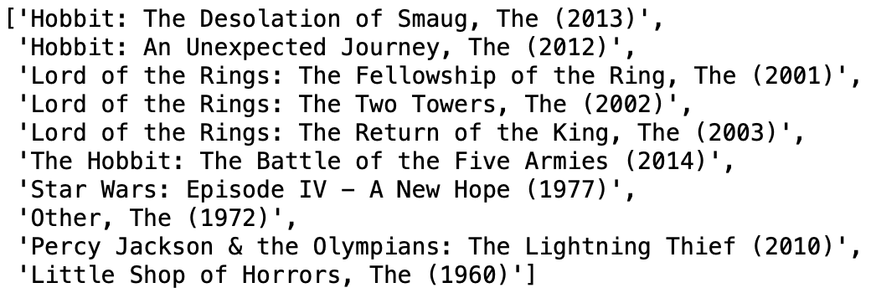
How?
Best rated movies of user 1:
Top 10 recommended movies to user 1:
Step 5:
Calculate the total weight of each movie and recommend the top 10 movies to the user.
In the previous case, ‘Hobbit: The Desolation of Smaug, The (2013)’ has the highest weight: 3+3+2 = 8, so it is recommend as the top 1 to the user.
Notes:
for step 5 we calculate the total weight of each movie in the list we got from step 4 and recommend the top 10 movies that have the highest total weight to the user. In the previous case, ‘Hobbit: The Desolation of Smaug, The (2013)’ has the highest total weight: 3+3+2 = 8, so it is recommended as the top 1 to the user. You can check the result on the right, obviously user 1 loves lord of the rings, not sure if you guys know the movie lord of the rings or not, hobbit is one of the main character in the movie and you can see that the first two recommended movies are Hobbit.

Slide 20
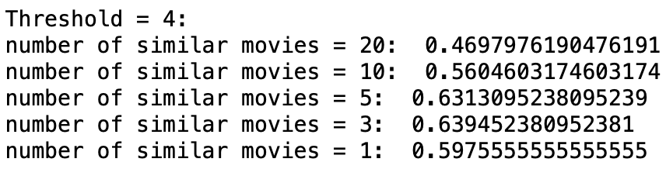
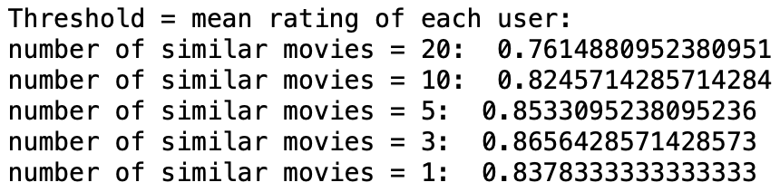
Evaluation
Evaluation metric: Precision at 10
Precision at 10: the percentage of good recommendation among the top 10 recommendation.
ex : Out of the 10 movies, the number of movies the user has watched before is 6 and among the 6 movies, 4 movies have higher ratings than the threshold ⇒ Precision = 4/6 = 0.66
Notes:
The metric to evaluate the performance of this model we used is precision at 10 since we are recommending 10 movies, precision at 10 basically means the percentage of good recommendation among the top 10 recommendation. For example, Out of the 10 movies, the number of movies a user has watched before is 6 and among the 6 movies, 4 movies have higher ratings than the threshold so the Precision = 4/6 = 0.66, the result is on the right, i will talk about it using graphs in the next slide.

Slide 21
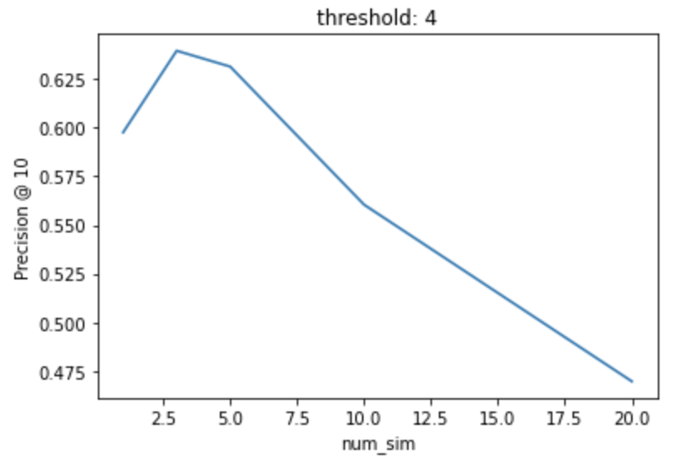
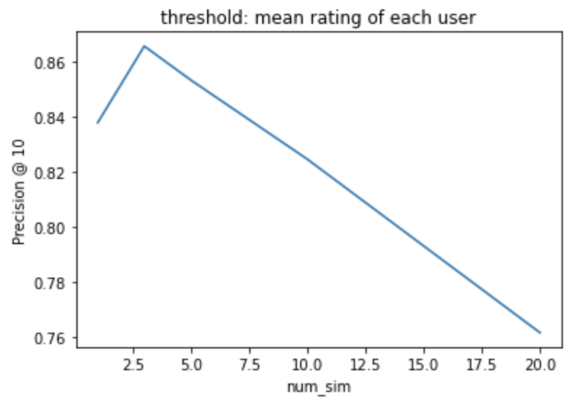
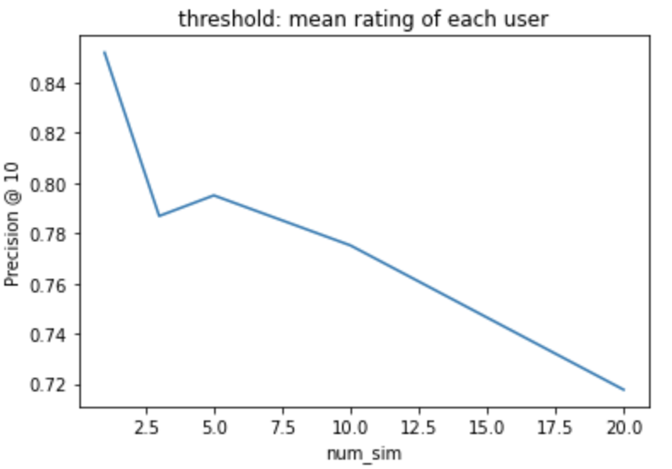
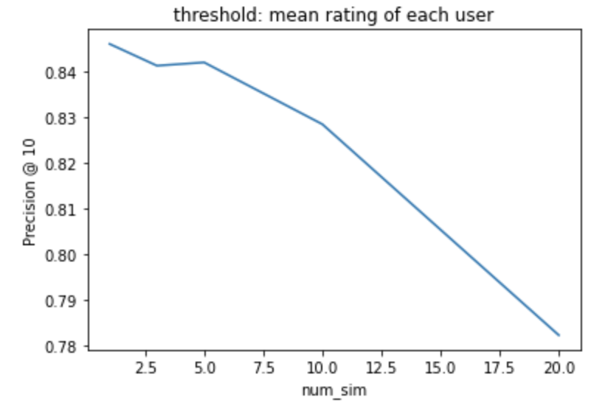
Result analysis
Threshold: rating that is considered “good” rating
In a 1-5 rating, 4 is considered good
Mean-centered rating, rating above mean rating of a user is considered “good”
Num_sim: number of similar movies returned when getting top k similar movies (step 5)
→ The more we include movies that have smaller similarities, the less accurate the model becomes.
Notes:
The num_sum in x-axis stands for number of similar movies returned when we try to find similar movies for a movie, and y axis is precision. The two graphs in the first row are the results of first iteration of evaluation using two different threshold. The first threshold is 4, choosing 4 is because in a rating with scale 1 to 5, 4 is considered “good”, the second threshold is the mean rating of each user, choosing this threshold is because each user has their own rating criteria, maybe for a user the highest rating he gives is 3.9 then a metric with threshold = 4 will not be a good metric. For the two graphs in the second row, they are the second and third iteration of evaluation with threshold = mean rating of each user. Its obvious that no matter what threshold we use, The more we include movies that have smaller similarities, the less accurate the model becomes, the ideal value of the hyper parameter number of similar movies for this model is around 3 to 5. overall , the precision looks fine, its about the same as the precision of the SVD model.

Slide 22
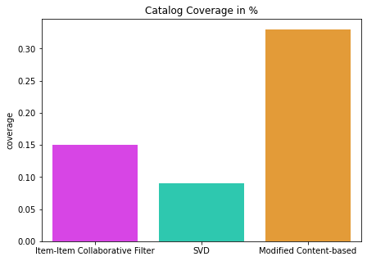
Comparison of Models
Coverage plot: prediction coverage of different models
Personalization: dissimilarity between recommended movie lists
Result: 0.62

Slide 23
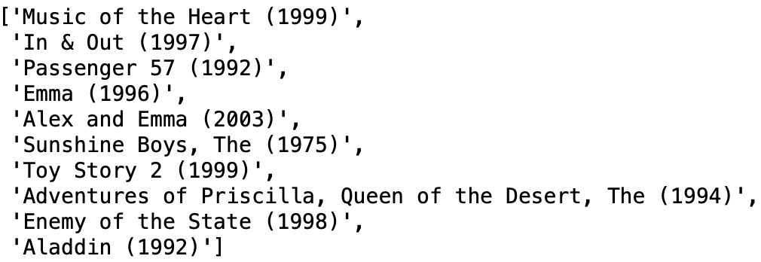
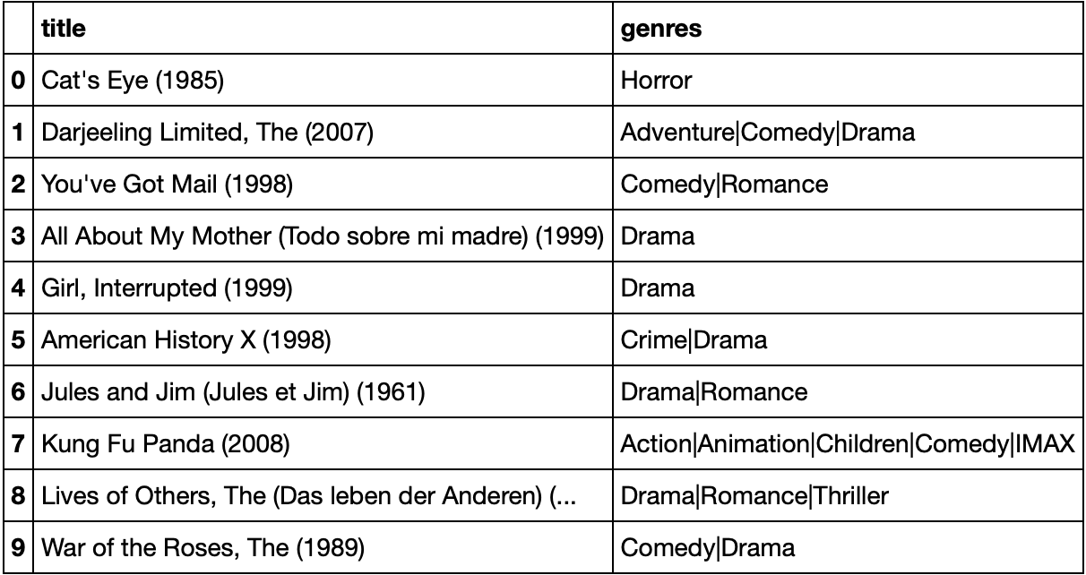
Comparison of models
Movies recommended by modified content-based
RMSE:
SVD < surprise item-based<item-item
Precision at 10:
SVD = modified content-based > surprise item-based
⇒ hybrid the two best method: SVD + modified content-based
Movies recommended by SVD

Slide 24
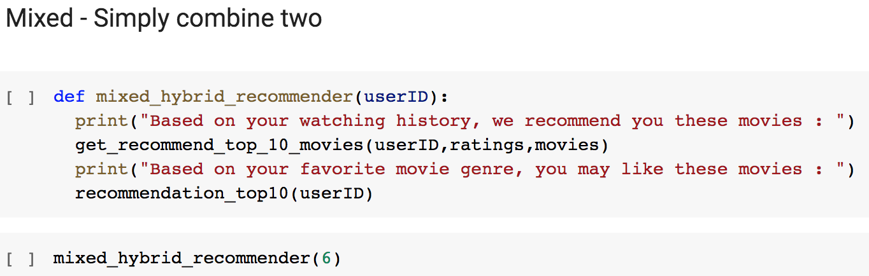
Hybrid Model
Mixed: Recommendations from different recommenders are presented together to give the recommendation.
Meta-level: One recommendation technique is applied and produces some sort of model, which is then the input used by the next technique.
SVD + Modified Content-based
Limitation : Due to the limitation of our computer(RAM crushed after running only one model), we couldn’t successfully run it
Notes:
We try to create a hybrid model which combines the SVD model and the Content-based model. We considered to use two way to set up the recommendation model as following:
Mixed: Recommendations from different recommenders are presented together to give the recommendation.
Meta-level: One recommendation technique is applied and produces some sort of model, which is then the input used by the next technique.
For the mixed hybrid model, we could simply present the results of the content-base model and SVD model at the same time. We also can use meta-level methodology to create a more accurate model. We first implement the SVD model and use the results of recommendation as input or selection set of content-base model. There is more to explore, but due to the limitation of our computer(RAM crushed after running only one model), we couldn’t successfully run it. But we can do more experiments in the future as long as we have the solution to the OOM problem.

Slide 25
Difficulties and Achievements
Large size of dataset: 20M MovieLens
Optimization on instance type: float64 to float32 (half memory space)
Process data in chunks
RAM limitation
Sometimes cannot fit all data into the models
Failed to run all the model on one computer
Performance of self-implemented algorithms
Long execution time
Implement evaluation functions

Slide 26
Thank you!

